Slide 1

Tensorflow

Slide 2
Anaconda
Package name: tensorflow
Version: 2.X.X

Slide 3
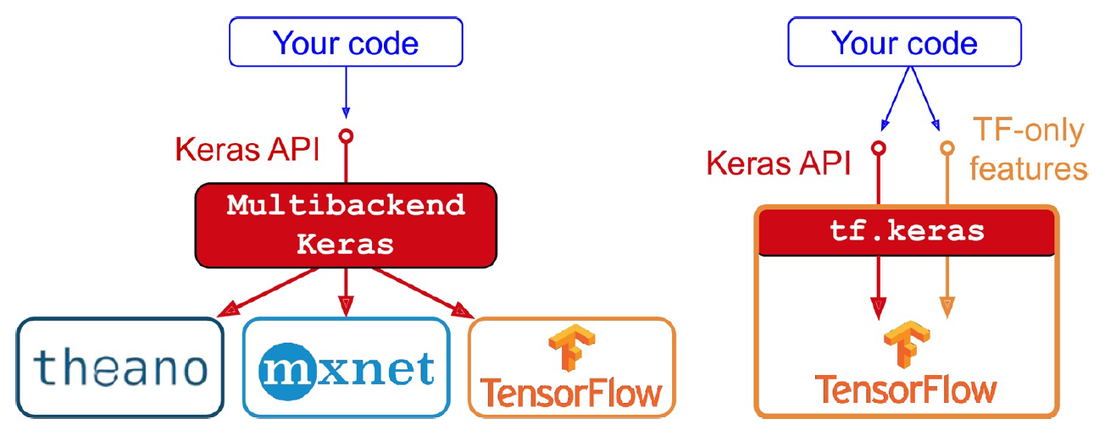
Keras Introduction
API for deep learning

Slide 4
Neural Network (tensorflow vs scikit-learn)
tensorflow
scikit-learn
Build neural network layer-by-layer, configurable
Validation loss and accuracy can be viewed during training
Special network structure – CNN, RNN, or custom structure
Unable to configure layer properties
Validation loss and accuracy can NOT be viewed during training
No special network structure

Slide 5
More on tensorflow
Save/Load Model
… Many other customizations are available
MORE FLEXIBILITY, MORE DIFFICULT

Slide 6
Training Neural Networks with Tensorflow
Choose X and y
Normalization of X and y
Train, validation splitting
Define model with tensorflow
Insert layers, choose suitable neuron type, activation, loss function (you may tweak by yourself later)
Start training

Slide 7
Function Selection
Regression Loss Functions
Mean Squared Error Loss
Mean Squared Logarithmic Error Loss
Mean Absolute Error Loss
Binary Classification Loss Functions
Binary Cross-Entropy
Hinge Loss
Squared Hinge Loss
Multi-Class Classification Loss Functions
Multi-Class Cross-Entropy Loss
Sparse Multiclass Cross-Entropy Loss
Kullback Leibler Divergence Loss

